Slide 1
What is deep learning?
Dr. Noman Islam

Slide 2
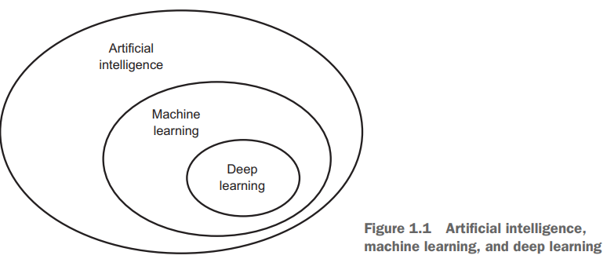

Slide 3
Artificial Intelligence
Artificial intelligence was born in the 1950s
The effort to automate intellectual tasks normally performed by humans
Early chess programs, for instance, only involved hardcoded rules crafted by programmers, and didn’t qualify as machine learning

Slide 4
Symbolic AI
For a fairly long time, many experts believed that human-level artificial intelligence could be achieved by having programmers handcraft a sufficiently large set of explicit rules for manipulating knowledge.
This approach is known as symbolic AI, and it was the dominant paradigm in AI from the 1950s to the late 1980s.
It reached its peak popularity during the expert systems boom of the 1980s.

Slide 5
Limitations of Symbolic AI
Although symbolic AI proved suitable to solve well-defined, logical problems, such as playing chess, it turned out to be intractable to figure out explicit rules for solving more complex, fuzzy problems, such as image classification, speech recognition, and language translation.
A new approach arose to take symbolic AI’s place: machine learning

Slide 6
Machine Learning
With machine learning, humans input data as well as the answers expected from the data, and out come the rules.
These rules can then be applied to new data to produce original answers.

Slide 7
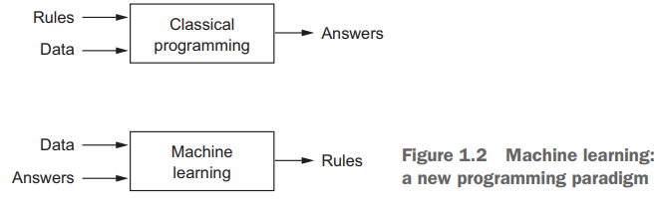

Slide 8
A machine-learning system is trained rather than explicitly programmed.
It’s presented with many examples relevant to a task, and it finds statistical structure in these examples that eventually allows the system to come up with rules for automating the task.

Slide 9
Requirements of Machine Learning
Input data points—For instance, if the task is speech recognition, these data points could be sound files of people speaking. If the task is image tagging, they could be pictures.
Examples of the expected output—In a speech-recognition task, these could be human-generated transcripts of sound files. In an image task, expected outputs could be tags such as “dog,” “cat,” and so on.

Slide 10
A way to measure whether the algorithm is doing a good job—This is necessary in order to determine the distance between the algorithm’s current output and its expected output. The measurement is used as a feedback signal to adjust the way the algorithm works. This adjustment step is what we call learning.

Slide 11
Representation Learning
The central problem in machine learning and deep learning is to meaningfully transform data: in other words, to learn useful representations of the input data at hand—representations that get us closer to the expected output.
Some tasks that may be difficult with one representation can become easy with another
Machine-learning models are all about finding appropriate representations for their input data—transformations of the data that make it more amenable to the task at hand, such as a classification task.

Slide 12
Learning, in the context of machine learning, describes an automatic search process for better representations.
They’re merely searching through a predefined set of operations, called a hypothesis space

Slide 13
Deep Learning
Deep learning is a specific subfield of machine learning: a new take on learning representations from data that puts an emphasis on learning successive layers of increasingly meaningful representations.
In deep learning, these layered representations are (almost always) learned via models called neural networks, structured in literal layers stacked on top of each other.

Slide 14
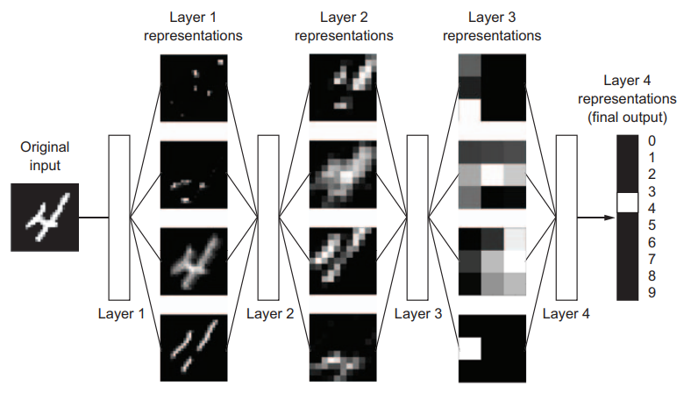
Multi-stage pipeline
You can think of a deep network as a multistage information-distillation operation, where information goes through successive filters and comes out increasingly purified

Slide 15
Weights
The specification of what a layer does to its input data is stored in the layer’s weights, which in essence are a bunch of numbers.
In technical terms, we’d say that the transformation implemented by a layer is parameterized by its weights

Slide 16
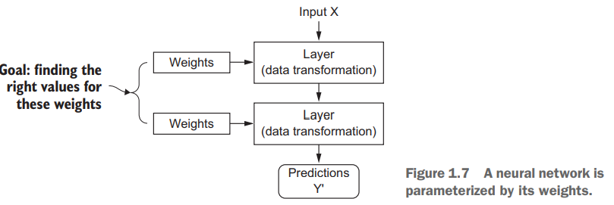

Slide 17
Loss function
To control the output of a neural network, you need to be able to measure how far this output is from what you expected.
This is the job of the loss function of the network, also called the objective function.
The loss function takes the predictions of the network and the true target (what you wanted the network to output) and computes a distance score, capturing how well the network has done on this specific example

Slide 18
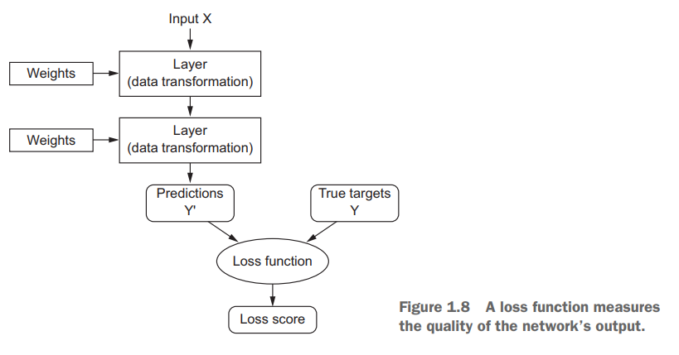

Slide 19
Backpropagation
The fundamental trick in deep learning is to use this score as a feedback signal to adjust the value of the weights a little, in a direction that will lower the loss score for the current example.
This adjustment is the job of the optimizer, which implements what’s called the Backpropagation algorithm: the central algorithm in deep learning.

Slide 20
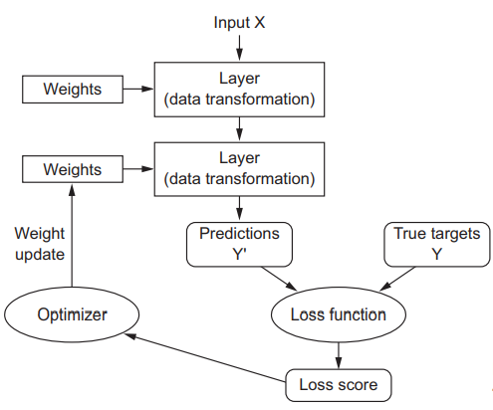

Slide 21
Deep Learning acheivements
Near-human-level image classification
Near-human-level speech recognition
Near-human-level handwriting transcription
Improved machine translation
Improved text-to-speech conversion
Digital assistants such as Google Now and Amazon Alexa
Near-human-level autonomous driving
Improved ad targeting, as used by Google, Baidu, and Bing
Improved search results on the web
Ability to answer natural-language questions
Superhuman Go playing

Slide 22
Don’t believe on short-term hype
Although some world-changing applications like autonomous cars are already within reach, but talk of human-level general intelligence shouldn’t be taken too seriously
The risk with high expectations for the short term is that, as technology fails to deliver, research investment will dry up, slowing progress for a long time.
This has happened before. Twice in the past

Slide 23
AI Winters
AI went through a cycle of intense optimism followed by disappointment and skepticism, with a dearth of funding as a result
It started with symbolic AI in the 1960
In the 1980s, a new take on symbolic AI, expert systems, started gathering steam among large companies.
We may be currently witnessing the third cycle of AI hype and disappointment— and we’re still in the phase of intense optimism.

Slide 24
It’s best to moderate our expectations for the short term and make sure people less familiar with the technical side of the field have a clear idea of what deep learning can and can’t deliver.

Slide 25
The promise of AI
Most of the research findings of deep learning aren’t yet applied, or at least not applied to the full range of problems they can solve across all industries.
Your doctor doesn’t yet use AI, and neither does your accountant.
You probably don’t use AI technologies in your day-to-day life
AI has yet to transition to being central to the way we work, think, and live

Slide 26
In a not-so-distant future, AI will be your assistant, even your friend; it will answer your questions, help educate your kids, and watch over your health.
It will deliver your groceries to your door and drive you from point A to point B.
It will be your interface to an increasingly complex and information-intensive world. And, even more important, AI will help humanity as a whole move forward, by assisting human scientists in new breakthrough discoveries across all scientific fields, from genomics to mathematics

Slide 27
A brief history of machine learning
Deep learning isn’t always the right tool for the job—sometimes there isn’t enough data for deep learning to be applicable, and sometimes the problem is better solved by a different algorithm.
If deep learning is your first contact with machine learning, then you may find yourself in a situation where all you have is the deep-learning hammer, and every machine-learning problem starts to look like a nail.
The only way not to fall into this trap is to be familiar with other approaches and practice them when appropriate

Slide 28
Probabilistic modeling
Probabilistic modeling is the application of the principles of statistics to data analysis.
One of the best-known algorithms in this category is the Naive Bayes algorithm.
Naive Bayes is a type of machine-learning classifier based on applying Bayes’ theorem while assuming that the features in the input data are all independent
A closely related model is the logistic regression (logreg for short), which is sometimes considered to be the “hello world” of modern machine learning.
Don’t be misled by its name—logreg is a classification algorithm rather than a regression algorithm.

Slide 29
Early neural networks
Although the core ideas of neural networks were investigated in toy forms as early as the 1950s, the approach took decades to get started
For a long time, the missing piece was an efficient way to train large neural networks.
This changed in the mid-1980s, when multiple people independently rediscovered the Backpropagation algorithm— a way to train chains of parametric operations using gradient-descent optimization

Slide 30
LeNet
The first successful practical application of neural nets came in 1989 from Bell Labs, when Yann LeCun combined the earlier ideas of convolutional neural networks and backpropagation, and applied them to the problem of classifying handwritten digits.
The resulting network, dubbed LeNet, was used by the United States Postal Service in the 1990s to automate the reading of ZIP codes on mail envelopes.

Slide 31
Kernel methods
Kernel methods are a group of classification algorithms, the best known of which is the support vector machine (SVM).
SVMs aim at solving classification problems by finding good decision boundaries between two sets of points belonging to two different categories.
A decision boundary can be thought of as a line or surface separating your training data into two spaces corresponding to two categories.
To classify new data points, you just need to check which side of the decision boundary they fall on

Slide 32
The data is mapped to a new high-dimensional representation where the decision boundary can be expressed as a hyperplane (if the data was twodimensional, a hyperplane would be a straight line).
A good decision boundary (a separation hyperplane) is computed by trying to maximize the distance between the hyperplane and the closest data points from each class, a step called maximizing the margin.
This allows the boundary to generalize well to new samples outside of the training dataset.

Slide 33
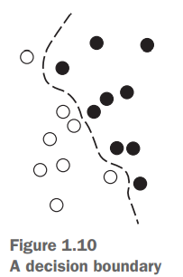

Slide 34
You don’t have to explicitly compute the coordinates of your points in the new space; you just need to compute the distance between pairs of points in that space, which can be done efficiently using a kernel function.
A kernel function is a computationally tractable operation that maps any two points in your initial space to the distance between these points in your target representation space, completely bypassing the explicit computation of the new representation.

Slide 35
Kernel functions are typically crafted by hand rather than learned from data—in the case of an SVM, only the separation hyperplane is learned.
SVMs proved hard to scale to large datasets and didn’t provide good results for perceptual problems such as image classification.
Because an SVM is a shallow method, applying an SVM to perceptual problems requires first extracting useful representations manually (a step called feature engineering), which is difficult and brittle.

Slide 36
Decision trees, random forests, and gradient boosting machines
Decision trees are flowchart-like structures that let you classify input data points or predict output values given inputs
They’re easy to visualize and interpret. Decisions trees learned from data began to receive significant research interest in the 2000s, and by 2010 they were often preferred to kernel methods.

Slide 37
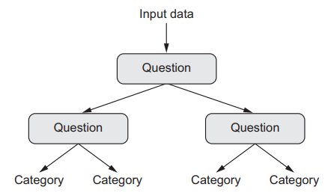

Slide 38
The Random Forest algorithm introduced a robust, practical take on decision-tree learning that involves building a large number of specialized decision trees and then ensembling their outputs.
Random forests are applicable to a wide range of problems—you could say that they’re almost always the second-best algorithm for any shallow machine-learning task
A gradient boosting machine, much like a random forest, is a machine-learning technique based on ensembling weak prediction models, generally decision trees.

Slide 39
It uses gradient boosting, a way to improve any machine-learning model by iteratively training new models that specialize in addressing the weak points of the previous models
It may be one of the best, if not the best, algorithm for dealing with nonperceptual data today. Alongside deep learning, it’s one of the most commonly used techniques in Kaggle competitions.

Slide 40
Back to neural networks
In 2011, Dan Ciresan from IDSIA began to win academic image-classification competitions with GPU-trained deep neural networks—the first practical success of modern deep learning.
But the watershed moment came in 2012, with the entry of Hinton’s group in the yearly large-scale image-classification challenge ImageNet.

Slide 41
Image Net Challenge
The ImageNet challenge was notoriously difficult at the time, consisting of classifying highresolution color images into 1,000 different categories after training on 1.4 million images.
In 2011, the top-five accuracy of the winning model, based on classical approaches to computer vision, was only 74.3%.
Then, in 2012, a team led by Alex Krizhevsky and advised by Geoffrey Hinton was able to achieve a top-five accuracy of 83.6%—a significant breakthrough.
The competition has been dominated by deep convolutional neural networks every year since

Slide 42
For several years, the European Organization for Nuclear Research, CERN, used decision tree–based methods for analysis of particle data from the ATLAS detector at the Large Hadron Collider (LHC); but CERN eventually switched to Keras-based deep neural networks due to their higher performance and ease of training on large datasets.

Slide 43
Why deep learning?
It completely automates what used to be the most crucial step in a machine-learning workflow: feature engineering
Previous machine-learning techniques—shallow learning—only involved transforming the input data into one or two successive representation spaces, usually via simple transformations such as high-dimensional non-linear projections (SVMs) or decision trees.
You learn all features in one pass rather than having to engineer them yourself.
This has greatly simplified machine-learning workflows, often replacing sophisticated multistage pipelines with a single, simple, end-to-end deep-learning model.

Slide 44
What is transformative about deep learning is that it allows a model to learn all layers of representation jointly, at the same time, rather than in succession (greedily, as it’s called).
With joint feature learning, whenever the model adjusts one of its internal features, all other features that depend on it automatically adapt to the change, without requiring human intervention.
Everything is supervised by a single feedback signal: every change in the model serves the end goal

Slide 45
This is much more powerful than greedily stacking shallow models, because it allows for complex, abstract representations to be learned by breaking them down into long series of intermediate spaces (layers); each space is only a simple transformation away from the previous one

Slide 46
Characteristics of deep learning
These are the two essential characteristics of how deep learning learns from data: the incremental, layer-by-layer way in which increasingly complex representations are developed, and the fact that these intermediate incremental representations are learned jointly, each layer being updated to follow both the representational needs of the layer above and the needs of the layer below.

Slide 47
The modern machine-learning landscape
In 2016 and 2017, Kaggle was dominated by two approaches: gradient boosting machines and deep learning.
Specifically, gradient boosting is used for problems where structured data is available, whereas deep learning is used for perceptual problems such as image classification.
Practitioners of the former almost always use the excellent XGBoost library, which offers support for the two most popular languages of data science: Python and R.

Slide 48
Meanwhile, most of the Kaggle entrants using deep learning use the Keras library, due to its ease of use, flexibility, and support of Python
So, gradient boosting machines, for shallowlearning problems; and deep learning, for perceptual problems. In technical terms, this means you’ll need to be familiar with XGBoost and Keras—the two libraries that currently dominate Kaggle competitions.

Slide 49
Why now?
In general, three technical forces are driving advances in machine learning:
Hardware
Datasets and benchmarks
Algorithmic advances

Slide 50
Hardware
Throughout the 2000s, companies like NVIDIA and AMD have been investing billions of dollars in developing fast, massively parallel chips (graphical processing units [GPUs]) to power the graphics of increasingly photorealistic video games— cheap, single-purpose supercomputers designed to render complex 3D scenes on your screen in real time.
This investment came to benefit the scientific community when, in 2007, NVIDIA launched CUDA (https://developer.nvidia.com/about-cuda), a programming interface for its line of GPUs.

Slide 51
Deep neural networks, consisting mostly of many small matrix multiplications, are also highly parallelizable; and around 2011, some researchers began to write CUDA implementations of neural nets—Dan Ciresan and Alex Krizhevsky were among the first.
Gaming market subsidized supercomputing for the next generation of artificial intelligence applications
Today, the NVIDIA TITAN X, a gaming GPU that cost $1,000 at the end of 2015, can deliver a peak of 6.6 TFLOPS in single precision: 6.6 trillion float32 operations per second. That’s about 350 times more than what you can get out of a modern laptop.

Slide 52
What’s more, the deep-learning industry is starting to go beyond GPUs and is investing in increasingly specialized, efficient chips for deep learning.
In 2016, at its annual I/O convention, Google revealed its tensor processing unit (TPU) project: a new chip design developed from the ground up to run deep neural networks, which is reportedly 10 times faster and far more energy efficient than top-of-the-line GPUs.

Slide 53
Data
If deep learning is the steam engine of this revolution, then data is its coal
The game changer has been the rise of the internet, making it feasible to collect and distribute very large datasets for machine learning.
Today, large companies work with image datasets, video datasets, and natural-language datasets that couldn’t have been collected without the internet.
User-generated image tags on Flickr, for instance, have been a treasure trove of data for computer vision.
So are YouTube videos.
And Wikipedia is a key dataset for natural-language processing

Slide 54
If there’s one dataset that has been a catalyst for the rise of deep learning, it’s the ImageNet dataset, consisting of 1.4 million images that have been hand annotated with 1,000 image categories (1 category per image).
But what makes ImageNet special isn’t just its large size, but also the yearly competition associated with it
As Kaggle has been demonstrating since 2010, public competitions are an excellent way to motivate researchers and engineers to push the envelope.
Having common benchmarks that researchers compete to beat has greatly helped the recent rise of deep learning

Slide 55
Algorithms
In addition to hardware and data, until the late 2000s, we were missing a reliable way to train very deep neural networks.
The key issue was that of gradient propagation through deep stacks of layers.
The feedback signal used to train neural networks would fade away as the number of layers increased.

Slide 56
This changed around 2009–2010 with the advent of several simple but important algorithmic improvements that allowed for better gradient propagation:
Better activation functions for neural layers
Better weight-initialization schemes, starting with layer-wise pretraining, which was quickly abandoned
Better optimization schemes, such as RMSProp and Adam

Slide 57
Finally, in 2014, 2015, and 2016, even more advanced ways to help gradient propagation were discovered, such as batch normalization, residual connections, and depthwise separable convolutions.

Slide 58
A new wave of investment
In 2011, right before deep learning took the spotlight, the total venture capital investment in AI was around $19 million, which went almost entirely to practical applications of shallow machine-learning approaches.
By 2014, it had risen to a staggering $394 million.
Meanwhile, large tech companies such as Google, Facebook, Baidu, and Microsoft have invested in internal research departments in amounts that would most likely dwarf the flow of venture-capital money.

Slide 59
Only a few numbers have surfaced: In 2013, Google acquired the deep-learning startup DeepMind for a reported $500 million—the largest acquisition of an AI company in history. In 2014, Baidu started a deep-learning research center in Silicon Valley, investing $300 million in the project.
The deep-learning hardware startup Nervana Systems was acquired by Intel in 2016 for over $400 million.

Slide 60
The democratization of deep learning
In the early days, doing deep learning required significant C++ and CUDA expertise, which few people possessed
Nowadays, basic Python scripting skills suffice to do advanced deep-learning research.
This has been driven most notably by the development of Theano and then TensorFlow—two symbolic tensor-manipulation frameworks for Python that support autodifferentiation, greatly simplifying the implementation of new models—and by the rise of user-friendly libraries such as Keras, which makes deep learning as easy as manipulating LEGO bricks

Slide 61
Deep Learning properties
Simplicity—Deep learning removes the need for feature engineering, replacing complex, brittle, engineering-heavy pipelines with simple, end-to-end trainable models that are typically built using only five or six different tensor operations.
Scalability—Deep learning is highly amenable to parallelization on GPUs or TPUs, so it can take full advantage of Moore’s law. In addition, deep-learning models are trained by iterating over small batches of data, allowing them to be trained on datasets of arbitrary size. (The only bottleneck is the amount of parallel computational power available, which, thanks to Moore’s law, is a fastmoving barrier.)

Slide 62
Versatility and reusability—Unlike many prior machine-learning approaches, deep-learning models can be trained on additional data without restarting from scratch, making them viable for continuous online learning—an important property for very large production models. Furthermore, trained deep-learning models are repurposable and thus reusable: for instance, it’s possible to take a deep-learning model trained for image classification and drop it into a videoprocessing pipeline.

